Slide 1

Behavioral health impacts of COVID-19
Workplace Trends, Resources, and Strategies:
Disaster Cascade and Long-Term Recovery Management
Kira Mauseth, Ph.D.
Behavioral Health Strike Team

Slide 2
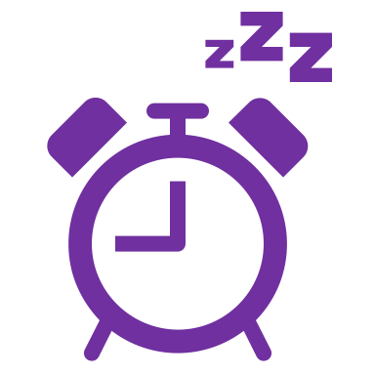
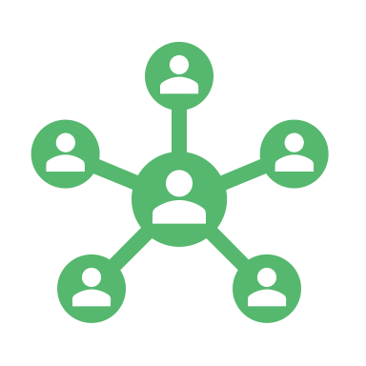


Agenda
The Behavioral Health landscape for the next few months
Understanding and managing burnout and exhaustion with a note on grief and loss
Workplace considerations: Communication and Social learning
Making resilience work for you in 2022: THRIVE
Washington State Department of Health | 2

Slide 3
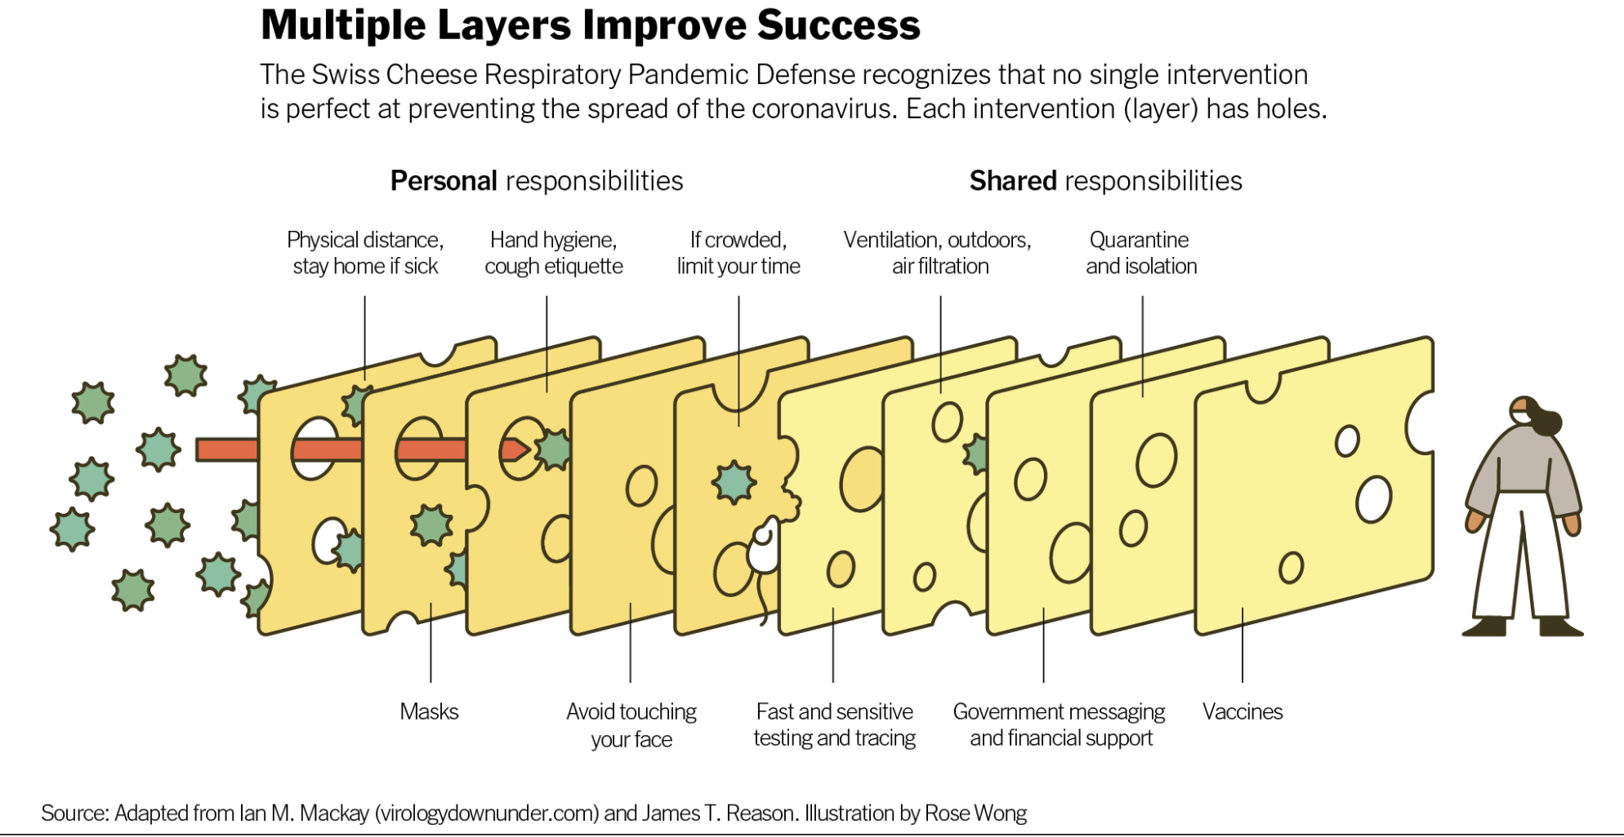

Slide 5
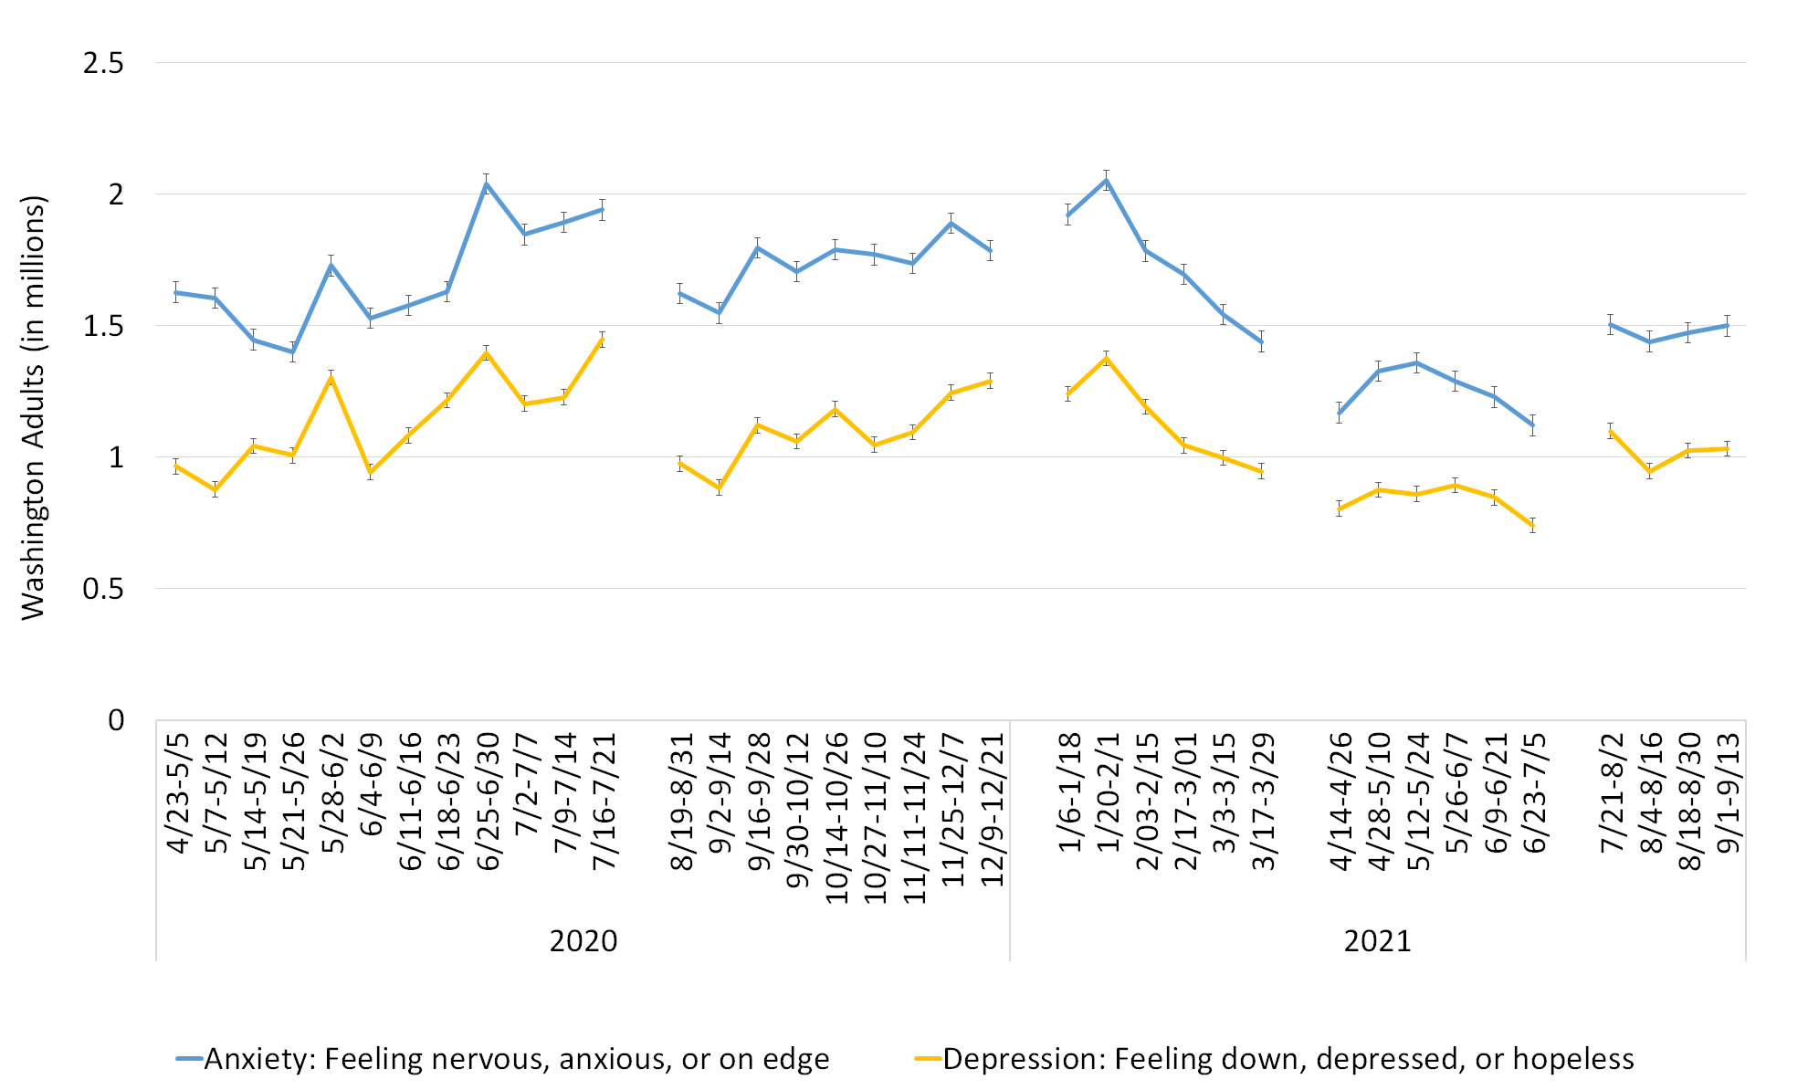
Anxiety and Depression- WA Adults

Slide 6
Key Takeaways
The potential for violence and aggression increases with ”hardening” of opinions, impulsivity, and sense (accurate or not) of being threatened (by changes, uncertainties, mandates, expectations, etc) in the workplace and in social settings.
”In-group” and “out-group” or “us / them” thinking is likely to result in a loss of social and workplace cohesion.
Communication challenges will be significant due to general dysregulation: we all have difficultly interpreting others’ motives and meanings.
  De-escalation and active listening continue to be highly recommended techniques for supporting others.
Planning, thinking through, and considering options ahead of time is a valuable part of the process as we move into the fourth quarter of 2021 and into 2022. Planning and identifying alternative options ahead of time reduces the likelihood of making impulsive, risky choices.

Slide 7
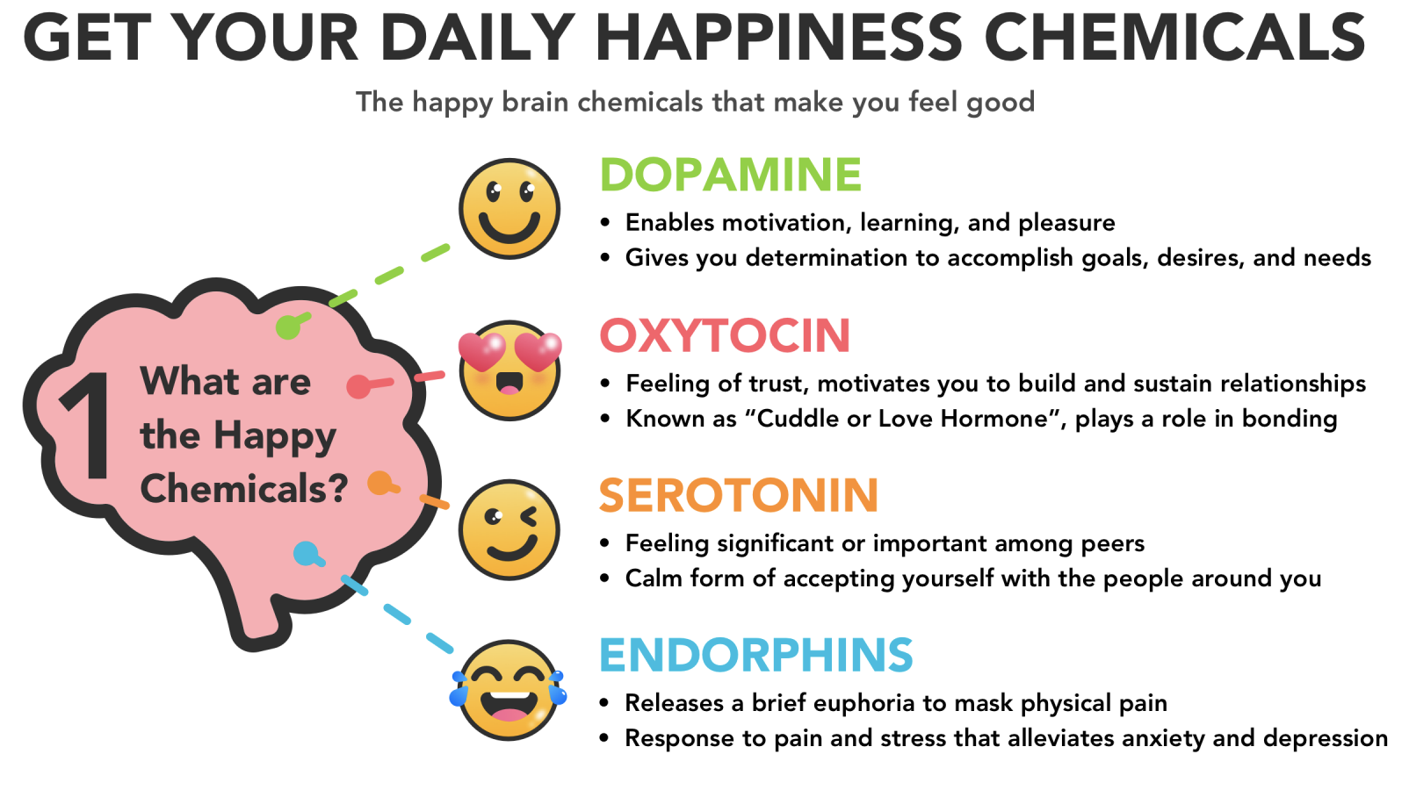
Washington State Department of Health | 7

Slide 8
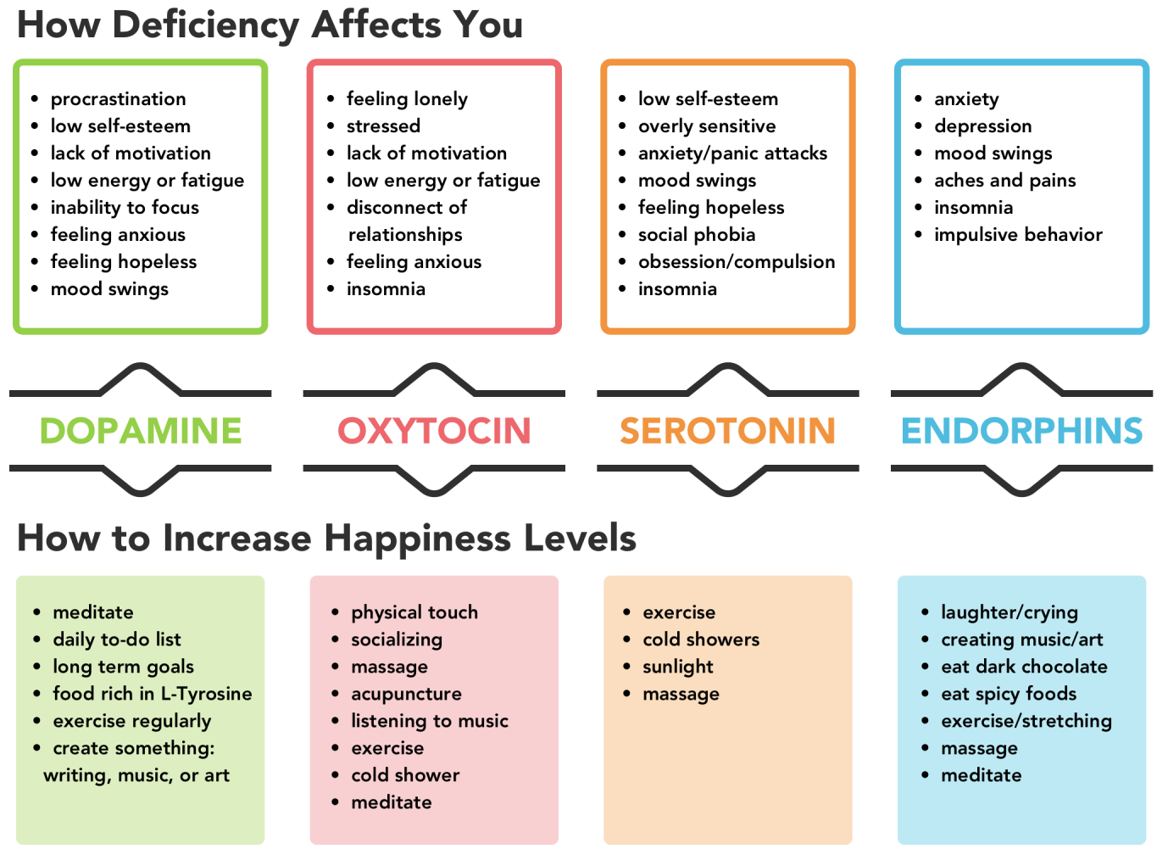


Slide 9
Burnout, Compassion Fatigue and Moral Injury
Burnout: Exhaustion of body, mind, and motivation due to exposure to prolonged and unresolved work stress or frustration. Burnout is often a consequence of perceived disparity between the demands of the job and the resources that an employee has available to them.
Compassion Fatigue: Emotional and physical exhaustion leading to a diminished ability to empathize or feel compassion for others, also described as secondary traumatic stress.
Moral Injury: Strong feelings of guilt, shame, or anger due to not being able to provide the kind of care or service you want and expect to provide.
Resilience: The process – involving behaviors, thoughts, and actions – of adapting well in the face of adversity, trauma, tragedy, threats, or significant sources of stress. Can be developed by focusing on connection, purpose, and flexibility/adaptability.

Slide 10
How to Manage and Reduce Burnout
Bottom line up front:
What do DO:
What to avoid:
Burnout is widespread in the context of a disaster. Our energy is more limited right now. Healthy, clear boundaries between work and time off are essential for reducing burnout.
Establish your “off time” boundaries. Hours, days or segments of time that are unavailable for work-related tasks.
List things you can do during time off that are completely unrelated to work (e.g., re-watch your favorite show, teach yourself a new hobby using online resources, get lost in a book).
Professional and social isolation
Saying “yes” when you need to say “sorry, no, I don’t have the capacity to do that right now”.
Feeling guilty for taking some mission critical time off.

Slide 11



Individual Level: Work/Time Boundaries
On-duty or at work
On-call or available
OFF
Washington State Department of Health | 11

Slide 12
How to Manage and Reduce Compassion Fatigue
Bottom line up front:
What to DO:
What to avoid:
Unhealthy coping practices (eg drinking too much alcohol)
Focusing on what “didn’t get done”.
Compassion rewards are the antidote for compassion fatigue. Take time to recognize the impact your work is having on others and celebrate victories when possible (even little ones).
Offer verbal support for colleagues (active listening is great! – when you have the capacity!).
Call out and attend to the wins, the successes and the “good stuff”.
Engage with others socially

Slide 13
How to Manage and Reduce Moral Injury
What to DO:
Bottom line up front:
What to avoid:
Create a schedule, try to add just one small thing each day you enjoy doing. Mindfulness practices (e.g., meditation and breathing practices) can be helpful.
If you have a personal history of trauma, consider professional care services to help process your experiences.
Moral injury is triggered by environmental circumstances, not personal failures. If you experience this, try to focus on external causes that can be addressed, not internal blame.
Ignoring or not attending to strong emotions related to your work experience.

Slide 14
The collective experience of Loss
Any loss right now is likely to touch on a deep well of loss that we all have experienced to some degree over the last year and a half.
Emotional reactions and responses may be proportionally stronger to ANY loss right now.
Emotion regulation is already a challenge when the brain is exhausted.
There is no right or wrong way, or specific timeframe for people to process grief and loss. Increasing resilience and moving forward with recovery will also differ for each person.
Focus on authentic reactions with the intention to support someone in pain, not to make them “feel better”.

Slide 15
Considerations for working with (or experiencing) grief, loss and bereavement
Facilitate problem solving and decision making to prevent impulsive or risky decisions (e.g., precautionary health measures, burial decisions);
Modify coping plans if traditional strategies aren’t possible (e.g., gathering with family to grieve through facetime);
Identify connections (relationships) of support for the person who is grieving
Focus on engaging in the simpler, more concrete tasks and activities that are uplifting so that the effects of self-efficacy can grow.
ACTIVE LISTENING is the recommended and preferred “intervention” to support anyone struggling with grief and loss.

Slide 16
Communication Basics
Zones of Regulation: Neurological influences on our ability to perceive, process and respond to others.
Active Listening: a strategy or technique used to further understanding and caring.
De-escalation: use the SAFE model to help others process their distress.

Slide 17
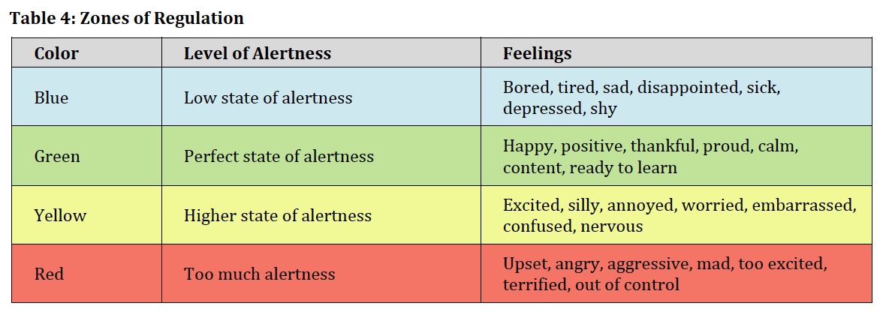
Communication
Zones of regulation
Remember how our pre-frontal cortex is influenced by stress.
No-one can have a logical ‘problem-solving’ oriented talk when they are ‘flooded’.
Take extra time to talk.
Get space from difficult conversations rather than continuing to push the issue.
Check in on levels of rest / tiredness before pursuing important conversations.
Think about how this plays out in families, at work and socially.

Slide 18
Active Listening
Clarify
Ask open ended questions
Reflect
Summarize what you think you heard
Express Empathy
Listen with the intent to Care, not problem solve

Slide 19
Working with Anger and Hostility:
SAFE Model © for De-Escalation
Many people are expressing distress about the pandemic in an external way. This often manifests itself as anger. In order to de-escalate yourself and others, the SAFE model provides key concepts to keep in mind:
Self: monitor your own reactions, non-verbal messages, tone, wording and physical space
Area Awareness: Be aware of resources, help, exits other things in your physical space
Feelings: Use active listening to try to uncover the source of the anger; in disasters often the things people are angry about are not the same thing as the underlying causes.
Engagement: Engage support for yourself if you have an encounter with an angry person, don’t just ignore it or pretend it didn’t happen.

Slide 20
Other Active Coping Techniques
Anxiety
Exhaustion
Depression
Sensory interventions:
  Frozen orange, ice
  Music
  Shower
  Fuzzy slippers
Apps
Breathing = calming
Sleep hygiene
  Same bed and wake times
  Alcohol and sugar considerations
  Notepad (not phone or laptop)
Apps
Boundaries
Behavioral activation: Small steps
Get a “this makes me feel better” list made on a good day
  5 minutes to 5 hours
Movement of any kind
Connection and support from others

Slide 21
Resilience
Purpose
Connection
Flexibility/
Adaptability
Hope

Slide 22
THRIVE with a focus on...
Transparency: continue to talk about things that bother you, and resilience.
Regulation: Take time before responding to others. Regulate your responses to avoid impulsive, risky or emotionally charged decision making.
Integration: Integrate your thoughts, feelings and behaviors to be as congruent as you can.
Values and Vision: Use your core values to help you map out HOW you want to engage with others.
Effort: Recognize and celebrate effort (for adults and youth alike) in the context of the limited emotional, cognitive and physical resources many of us have right now.
Health: Include your behavioral health in your focus on health. What is good for you emotionally and mentally?

Slide 23
What works for you?
Identify things that have helped you before
Be willing to try new things
Don’t dismiss outside time- especially in the fall and winter months
Any physical activity will help neurologically
Try to engage in active coping strategies as much as you can (rather than passive / avoidant coping, such as substance use).

Slide 24
Key takeaways
Take time and pause before responding (via email, text, in person)
Develop awareness of your personal physical response to unexpected, negative events; regulation can start with this insight.
Resilience is a process, not an accomplishment or a badge to be won.

Slide 25
Resources
Training:
Health Support Team (including train-the-trainer)
PsySTART-Responder (frontline healthcare only)
Resources:
MEDIC, REST, SAFE, and PEACE Models
Behavioral Health Group Impact Reference Guide
  Healthcare and behavioral health providers, outreach teams, post critical care individuals, etc.
  Unique challenges and considerations
  Support strategies (organizational, supervisory, and personal)
Children and families: Behavioral Health Toolbox for Families: Supporting Children and Teens During the COVID-19 Pandemic; Back to Classroom THINK toolbox for parents, teachers, caregivers and mentors: https://www.doh.wa.gov/Portals/1/Documents/1600/coronavirus/821-148-BackToClassroomToolbox.pdf
Businesses and workers: COVID-19 Guidance for Building Resilience in the Workplace

Slide 26
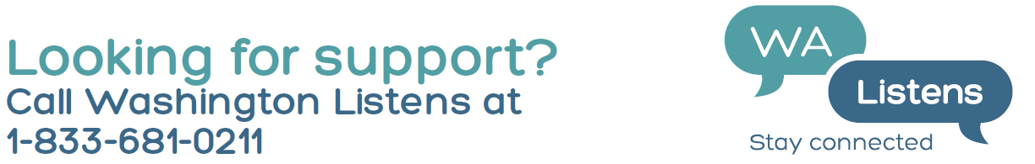
Resources (continued)
Webpages:
DOH – Forecasts, situation reports, guidance, and other resources:
Behavioral Health Resources Webpage
Children and families: Behavioral Health Toolbox for Families: Supporting Children and Teens During the COVID-19 Pandemic
State – General mental health resources and infographics:
Mental and Emotional Well-Being Resources
Infographic Library
A Mindful State: https://amindfulstate.org/

